Slide 1

Gambling Among Adults Experiencing Poverty and Homelessness
A Learning Module for Service Providers

Slide 2

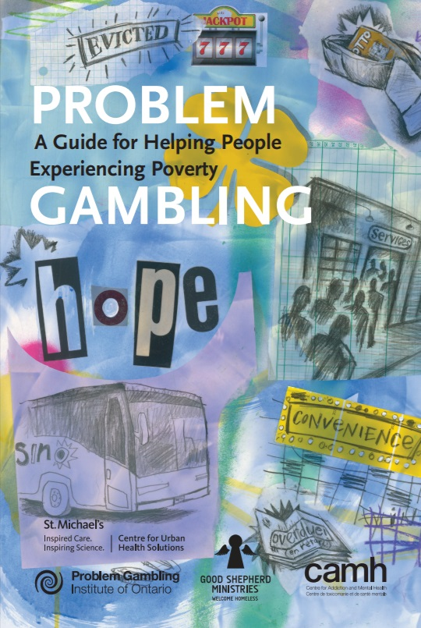
Once you have completed this module, you will:
GAMBLING AMONG ADULTS EXPERIENCING POVERTY AND HOMELESSNESS
Understand the relationship between problem gambling and poverty.
Discover ways to have conversations with clients experiencing problem gambling.
Know how to screen clients experiencing problem gambling.
Be better prepared to provide support to clients to reduce gambling-related harms (e.g., cut down or quit gambling).
Notes:
Today I will be speaking about the relationship between problem gambling and poverty. The goal of today’s module will be to enhance your knowledge and skills so that you’re able to work more effectively with low income and homeless adults who are experiencing problem gambling.
During this module we will be discussing tips for having conversations with clients experiencing problem gambling, and I will explain ways to identify clients who are experiencing problem gambling. Finally we’ll talk about ways to support clients in their attempts to cut down or quit gambling.
PROBLEM GAMBLING: A Guide for Helping People Experiencing Poverty is meant to supplement this module. Throughout the module I’m going to point to some tools that will be useful in your interactions. Please write thoughts in the workbook provided.
Once you have completed this module, you will:
Understand the relationship between problem gambling and poverty.
Discover ways to have conversations with clients experiencing problem gambling.
Know how to screen clients experiencing problem gambling.
Be better prepared to provide support to clients to reduce gambling-related harms (e.g., cut down or quit gambling).

Slide 3
Exercise 1: Client challenges
GAMBLING AMONG ADULTS EXPERIENCING POVERTY AND HOMELESSNESS
What challenges do your clients face?
What types of strategies do you use to help your clients cope with and overcome their challenges?
Have any of your clients talked to you about gambling concerns?
If yes, how did you come to know about their gambling and how did you address it?
Notes:
In this module you will be asked to participate in several interactive exercises. Each workbook in front of you includes a description of each interactive exercise so that you can follow along and space for writing your thoughts. Some interactive exercise include a discussion component so that each participant can share their thoughts with the entire group or in smaller more intimate groups. The first interactive exercise asks you to begin thinking about the challenges your clients face so that you can reflect on them as you are completing the module. Write down your thoughts in the space provided and consider these questions as the module progresses:
What challenges do your clients face?
What types of strategies do you use to help your clients cope with and overcome their challenges?
Have any of your clients talked to you about gambling concerns? If yes, how did you come to know about their gambling and how did you address it?

Slide 4
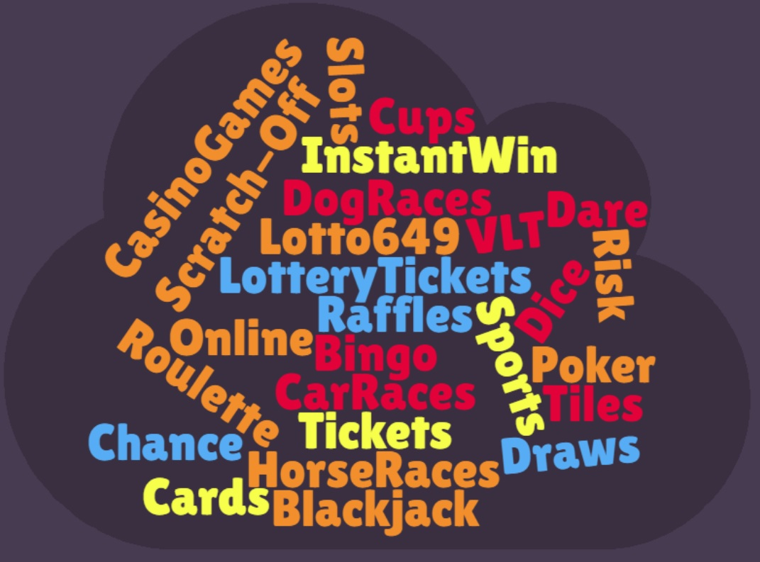
GAMBLING AMONG ADULTS EXPERIENCING POVERTY AND HOMELESSNESS
Notes:
Although many forms of gambling are similar, research suggests that individuals who play slot machines have a higher propensity to develop disordered gambling than any other form of gambling. Other common types of gambling include:
Cards
Dice games
Horse, dog, or car races
Bingo
Raffles
Lottery or scratch-off tickets
Slot or Video Lottery Terminal machines
Sports betting
Betting on games of skill (chess, mahjong, darts, pool, etc)
Online betting
Nontraditional forms of gambling like online gambling are problematic for a number of reasons: Online gaming sites lack any regulation which may make them particularly risky. It is also easily accessible, and can be conducted virtually anywhere hidden from others. Finally, online gambling can be thought of as “just a game”, especially if virtual credit is used, causing people to underestimate the amount of harm online gambling is capable of.
This is especially relevant for youth who have easy access to online forms of gambling. Young brains are less equipped to make long term, rational decisions in comparison to more developed brains. Starting unhealthy behaviors such as compulsive gambling at young age can cause addiction problems later on. Although many forms of gambling are similar, research suggests that individuals who play slot machines have a higher propensity to develop disordered gambling than any other form of gambling. Other common types of gambling include:
Cards
Dice games
Horse, dog, or car races
Bingo
Raffles
Lottery or scratch-off tickets
Slot or Video Lottery Terminal machines
Sports betting
Betting on games of skill (chess, mahjong, darts, pool, etc)
Online betting
Nontraditional forms of gambling like online gambling are problematic for a number of reasons: Online gaming sites lack any regulation which may make them particularly risky. It is also easily accessible, and can be conducted virtually anywhere hidden from others. Finally, online gambling can be thought of as “just a game”, especially if virtual credit is used, causing people to underestimate the amount of harm online gambling is capable of.
This is especially relevant for youth who have easy access to online forms of gambling. Young brains are less equipped to make long term, rational decisions in comparison to more developed brains. Starting unhealthy behaviors such as compulsive gambling at young age can cause addiction problems later on. Although many forms of gambling are similar, research suggests that individuals who play slot machines have a higher propensity to develop disordered gambling than any other form of gambling. Other common types of gambling include:
Cards
Dice games
Horse, dog, or car races
Bingo
Raffles
Lottery or scratch-off tickets
Slot or Video Lottery Terminal machines
Sports betting
Betting on games of skill (chess, mahjong, darts, pool, etc)
Online betting
Nontraditional forms of gambling like online gambling are problematic for a number of reasons: Online gaming sites lack any regulation which may make them particularly risky. It is also easily accessible, and can be conducted virtually anywhere hidden from others. Finally, online gambling can be thought of as “just a game”, especially if virtual credit is used, causing people to underestimate the amount of harm online gambling is capable of.
This is especially relevant for youth who have easy access to online forms of gambling. Young brains are less equipped to make long term, rational decisions in comparison to more developed brains. Starting unhealthy behaviors such as compulsive gambling at young age can cause addiction problems later on.

Slide 5
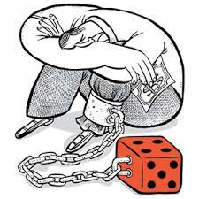
GAMBLING AMONG ADULTS EXPERIENCING POVERTY AND HOMELESSNESS
What is gambling?
People are gambling whenever they risk money or something of value on events that have an element of chance. For an activity to be considered gambling, the following elements need to be in place:
A person puts up money or something else of value.
The outcome is in some way beyond the person’s control.
Once the bet is made, it is irreversible.
Notes:
People are gambling whenever they risk money or something of value on events that have an element of chance. People may use gambling as a way to generate money for basic needs, to socialize, to cope with negative feelings such as depression, grief, boredom, loneliness, or to escape from their difficulties. They may use gambling to distract them from thinking about previous gambling related losses. Sometimes people gamble because they enjoy it. When someone has a gambling problem they often continue to gamble in an attempt to win back lost money. This is called “chasing losses” and is extremely common among people experiencing gambling problems. For them, gambling is the problem, but it also appears to be the solution.
For an activity to be considered gambling, the following elements need to be in place:
A person puts up money or something else of value.
The outcome is in some way beyond the person’s control.
Once the bet is made, it is irreversible

Slide 6

GAMBLING AMONG ADULTS EXPERIENCING POVERTY AND HOMELESSNESS
People experiencing poverty and homelessness are much more likely to have a history of gambling problems than the general population.
Notes:
People experiencing poverty and homelessness are much more likely to have a history of gambling problems than the general population. These people may have experienced multiple losses in their lives, including their job, housing, family, or health. Gambling may be used as a way to cope with or distract them from thinking about these losses. Additionally, people living in poverty are more vulnerable to experiencing further losses because of a limited financial safety net. Some people may even gamble as a way to generate income.
Recent studies found that rates of problem and/or pathological gambling among adults experiencing complex vulnerabilities such as homelessness and poverty are much higher than the general population, up to as high as 35% for pathological and problem gambling combined compared to 5-8% for the general population.

Slide 7
GAMBLING AMONG ADULTS EXPERIENCING POVERTY AND HOMELESSNESS
Risk factors specific to problem gambling
An early win in their gambling experience.
Easy access to their preferred form of gambling (e.g., the corner store).
Problems with alcohol or other drugs, especially if they gamble while under the influence.
Self-esteem is attached to gambling wins or losses.
Mistaken beliefs about the games.
Wins and losses are not tracked.
A family history of gambling.
Notes:
You may be more familiar with general risk factors for addiction such as experiences of trauma, depression, or loss. There are, however, risk factors specific to problem gambling in addition to those listed above. The more factors that apply, the more likely a person is to develop a gambling problem. These factors may include:
An early win in their gambling experience.
Easy access to their preferred form of gambling (e.g., the corner store).
Problems with alcohol or other drugs, especially if they gamble while under the influence.
Self-esteem is attached to gambling wins or losses.
Mistaken beliefs about the games.
Wins and losses are not tracked.
A family history of gambling.

Slide 8
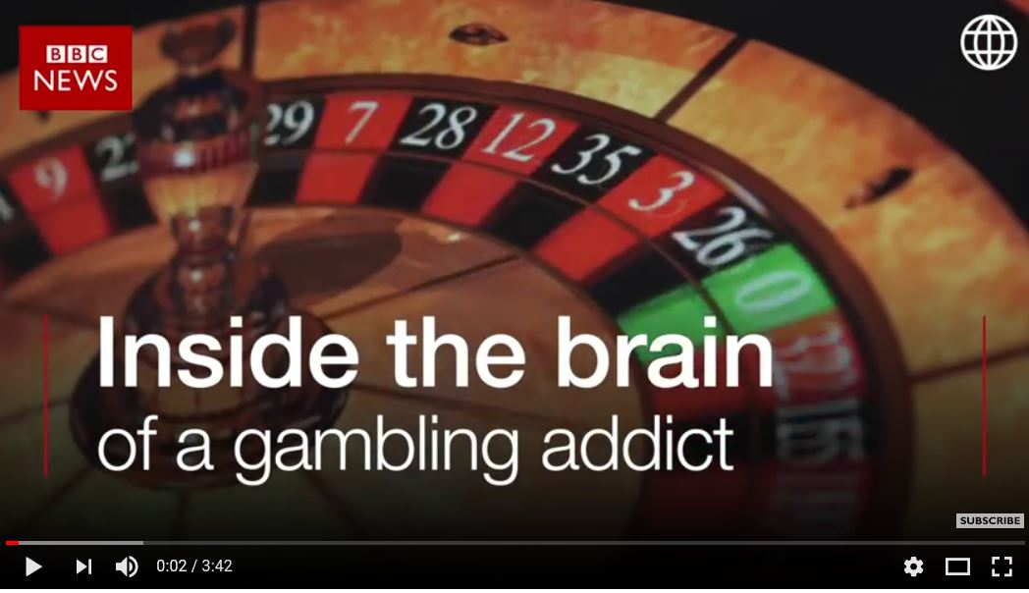
GAMBLING AMONG ADULTS EXPERIENCING POVERTY AND HOMELESSNESS
Notes:
Youtube video: Inside the brain of a gambling addict - BBC (3:42)
https://youtu.be/BF5SzIN63w8
Problem gambling is referred to as a behavioural addiction and it has a lot in common with substance use and other addictions. Studies have shown that gambling can increase levels of dopamine in the brain. Dopamine is a neurotransmitter that is responsible for feelings of pleasure and reward. The person gambling gets a reward when dopamine levels increase in their brain. These increased feelings of pleasure can happen even in anticipation of gambling and contribute to the desire to keep playing despite the negative consequences.

Slide 9
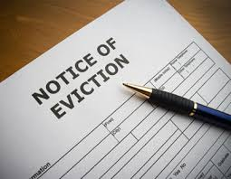
GAMBLING AMONG ADULTS EXPERIENCING POVERTY AND HOMELESSNESS
When does gambling become a problem?
Problem gambling can affect a person’s life beyond just losing money. Gambling is a problem when it:
Causes or worsens financial problems.
Impacts housing stability or employment.
Causes harms in relationships.
Continues despite the negative consequences.
Notes:
Gambling is a problem when it:
Causes or worsens financial problems.
Impacts housing stability or employment.
Causes harms in relationships.
Continues despite the negative consequences.
Problem gambling is a pattern of behaviour and people experience these harms repeatedly over time. Problem gambling can affect a person’s life beyond just losing money. Sometimes, gambling problems come to light when a person is at risk of losing their housing due to non-payment of rent. When their situation is examined, it appears as though nothing has changed financially. The situation can seem like a mystery to a service provider: Why is the client suddenly not able to pay their rent and doesn’t seem to have enough money to manage when they were previously able to? This is a red flag that is often hidden and missed. It is important to address problem gambling and homelessness concurrently due to the high rates of problem gambling among this vulnerable population.
On a more severe scale, pathological gambling refers to a mental disorder characterized by a chronic and irresistible impulse to gamble. Persons with problem gambling are at risk for other comorbidities such as depression, anxiety disorders and suicidal ideation, as well as substance use problems. Similarly, people who experience persistent financial instability are high risk for both substance abuse and problem gambling. It is important to address problem gambling and homelessness concurrently due to the high rates of problem gambling among this vulnerable population.

Slide 10
GAMBLING AMONG ADULTS EXPERIENCING POVERTY AND HOMELESSNESS
Exercise 2: Signs of problem gambling
What do you think are some signs that your client may be developing, or has developed, a gambling problem?
Notes:
What do you think are some signs that your client may be developing, or has developed, a gambling problem?
Gambling problems may not always be obvious. Remember, problem gambling is not just about the loss of money, but how it can affect someone’s whole life.
Some of the common signs of problem gambling you may see in your clients are :
Frequently borrows money or asks for advances.
Alternates between being broke and having money.
Thinks and talks about gambling all the time.
Neglects personal responsibilities.
Demonstrates a pattern of returning to gambling in order to recover. or “win back” losses.
Being irritated or restless when not able to gamble.
After gambling, client expresses:
Remorse.
Guilt.
Depressed feelings.
Hopelessness.
Fear of others finding out.
Worry over where they will get money to cover living expenses.
Anger towards themselves, or family and friends.

Slide 11

GAMBLING AMONG ADULTS EXPERIENCING POVERTY AND HOMELESSNESS
Harms from problem gambling
Notes:
Play video from 0:00 – 0:00

Slide 12
GAMBLING AMONG ADULTS EXPERIENCING POVERTY AND HOMELESSNESS
Harms from problem gambling
People with limited income may lose small amounts of money and still experience negative consequences of gambling. They may:
Owe people money.
Lose money they need to pay rent or buy food (basis necessities).
Turn to risky activities, such as crime or involvement in sex work, to get money to pay off gambling-related debts.
Be unable to maintain stable housing.
Notes:
People with limited income may lose small amounts of money and still experience negative consequences of gambling. They may:
Owe people money.
Lose money they need to pay rent or buy food (basis necessities).
Turn to risky activities, such as crime or involvement in sex work, to get money to pay off gambling-related debts.
Be unable to maintain stable housing.

Slide 13
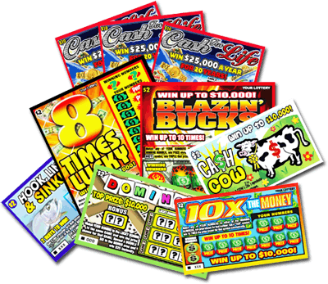
GAMBLING AMONG ADULTS EXPERIENCING POVERTY AND HOMELESSNESS
Client perceptions of problem gambling
People may not recognize they have a problem with gambling. You can, however, “plant a seed” and hope that they will think about it.
Notes:
People may not recognize they have a problem with gambling. You can, however, “plant a seed” and hope that they will think about it.
It is a good idea to ease into conversations about problem gambling by first asking your client how they spend their leisure time, and what their budget looks like before questioning them about gambling.
By having brief conversations with your clients, you can support them to see and understand their gambling behaviours differently. If they do not think it is a problem, then you can help by opening a dialogue and providing information. It is important to recognize that gambling may not in fact be a problem for them.
People also may have mixed feelings about gambling. They may recognize that it is causing problems. They may feel anxious, depressed, angry or ashamed, but they enjoy the ritual of gambling and the hope and excitement that it offers. Some people who are dealing with poverty or homelessness may enjoy gambling because it provides a distraction and gives them hope that a win will solve their problems. They may not see gambling as a problem and may have no desire to change their behaviour.

Slide 14
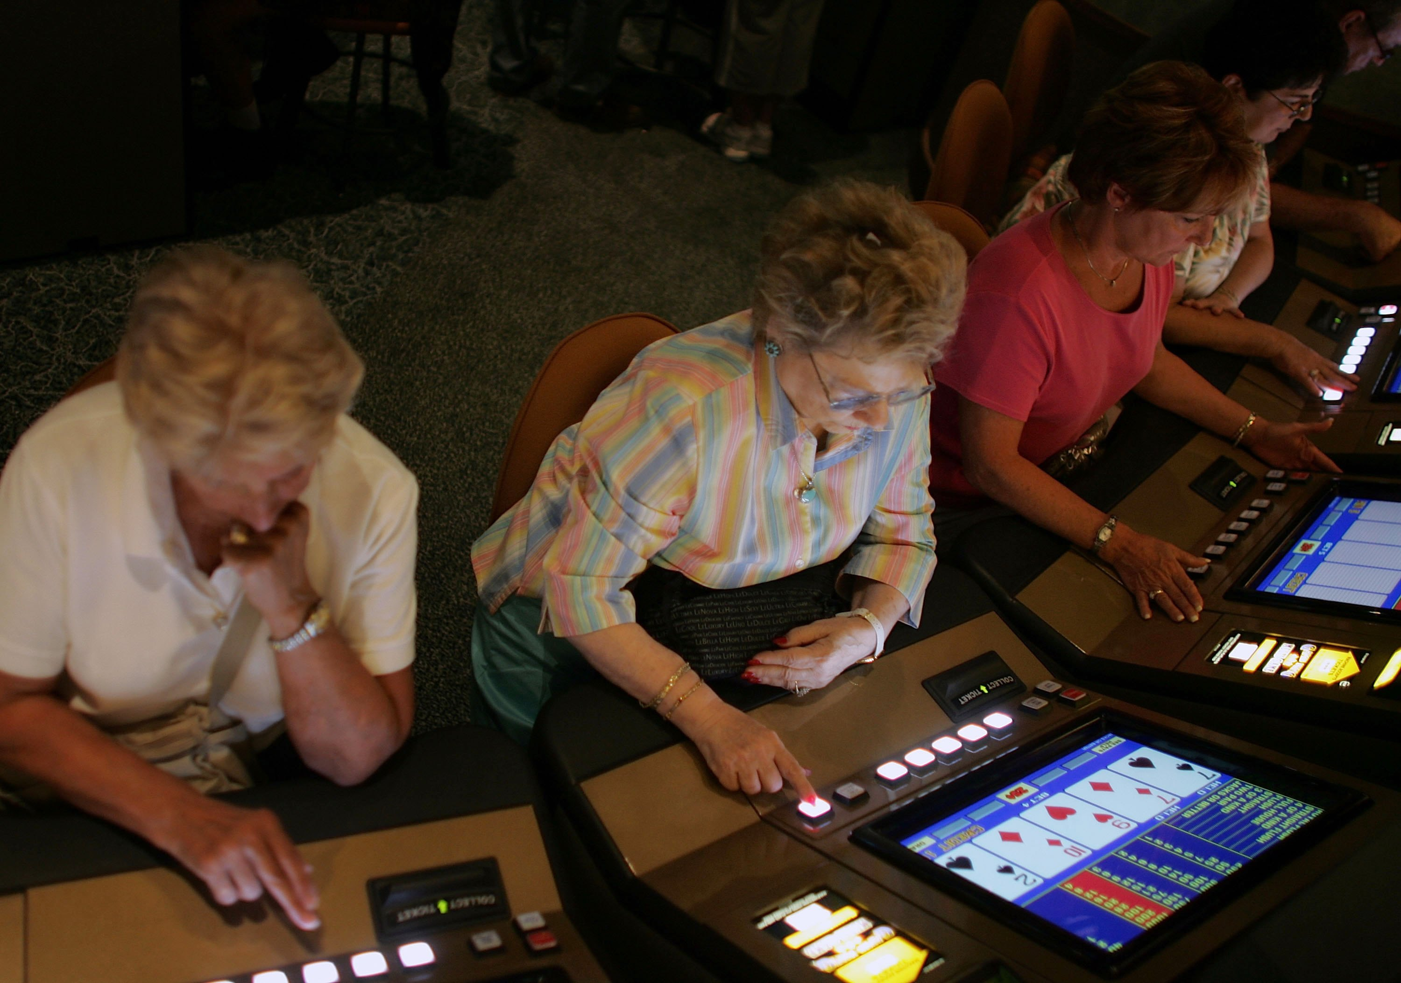
GAMBLING AMONG ADULTS EXPERIENCING POVERTY AND HOMELESSNESS
Women and gambling
The number of women with gambling concerns is on the rise.
Women are more likely to:
Play non-competitive, continuous games such as slots, lottery, instant win and bingo.
Consider gambling a distraction from worries or loneliness.
Notes:
The ratio of men to women among problem gamblers has been estimated at between 2:1 and 3:1. With changes in the availability and legal status of many gambling activities, it would seem that the number of women with problem gambling is on the rise.
While men are more likely to participate in a wider variety of gambling activities, and are drawn to games that are competitive and esteem building such as poker and blackjack, women are more likely to play non-competitive, continuous games such as slots, lottery, instant win and bingo.
Young women who gamble are more likely to report gambling as an escape from difficulties rather than as a competitive activity. Older women who gamble are more likely to report gambling as a distraction, to escape loneliness and as a way to “get out of the house”. It is important to remember that gambling among women can telescope into a serious problem quickly because women may have less access to money because their finances are controlled by a partner.
When asked to describe the negative consequences and positive aspects of gambling and how this related to seeking help for, and recovery from, problem gambling, men reported that the emotional response to the addiction (the shame, anxiety, sense of failure, depression, and anger) was a major obstacle to recovery, while for women it was the seductiveness of the gambling environment (potential to resolve financial problems, acquire large sums of money quickly, and receive perks from casinos).

Slide 15
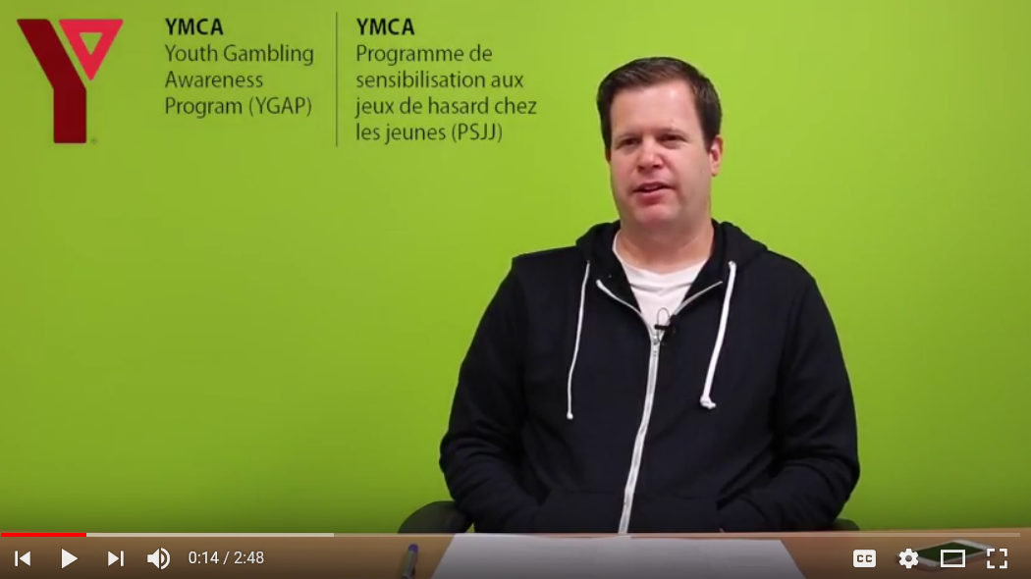
GAMBLING AMONG ADULTS EXPERIENCING POVERTY AND HOMELESSNESS
Stigma prevents help seeking for gambling concerns
Notes:
https://www.youtube.com/watch?v=VlyqCn-OpmE&list=PLsnJJTyXnkJ-UHqZzlsUL6Ip8TDA98gA2&index=2 YGAP - PG Stigma (John)

Slide 16

GAMBLING AMONG ADULTS EXPERIENCING POVERTY AND HOMELESSNESS
Exercise 3: Discussing problem gambling
How would you have a conversation about gambling with one of your clients?
Notes:
How would you have a conversation about gambling with one of your clients?
What types of questions would you ask your client if you wanted to learn more about their gambling concerns?

Slide 17
GAMBLING AMONG ADULTS EXPERIENCING POVERTY AND HOMELESSNESS
Talk with your clients about gambling
Clients may keep their gambling concerns secret because they feel ashamed, embarrassed, or concerned about the repercussions of revealing this information.
Create a safe and supportive environment.
Engage your client with compassion and empathy.
Notes:
Talking about gambling and its potential harms with your clients is very similar to discussing any other harmful behaviour that someone may be engaging in. The skills you have and the rapport you have developed with your clients can help you to address this issue just like any other.
Asking about gambling regularly will help to normalize those conversations so that this becomes one of the topics your clients expect to talk about.
When you ask a client about gambling, you are letting them know that it is something that is okay to talk about. They may not respond the first time, but hopefully, the more you talk about gambling, the more familiar and comfortable it will be-come for your clients to talk about.
Clients may keep their gambling concerns secret because they feel ashamed, embarrassed, or concerned about the repercussions of revealing this information. Therefore, it is essential to create a safe and supportive environment and engage your client with compassion and empathy.

Slide 18

GAMBLING AMONG LOW INCOME ADULTS WITH COMPLEX NEEDS
Talk with your clients about gambling
When talking to clients about gambling, it is helpful to name the specific games that are available. A client may, for example, tell you that they buy scratch tickets. This gives you an opportunity to show interest and talk with them about their play without assuming that it is problematic.
Notes:
When talking to clients about gambling, it is helpful to name the specific games that are available. A client may, for example, tell you that they buy scratch tickets. This gives you an opportunity to show interest and talk with them about their play without assuming that it is problematic.
Showing curiosity and asking about gambling activities creates an opportunity to provide information about the odds or safer gambling strategies. Ask questions like:
Which games do you play?
How does it work?
How often do you play?
Do you win?
Ask about their finances – do they have enough money to make it to the end of the month? OR were they short of money to pay their rent or to buy food?
Asking general questions such as “How much do you gamble?” may cause clients to respond that they don’t gamble at all.
It is also important to focus on the negative consequences a client experiences as a result of their gambling because some clients may struggle to see the consequences of their gambling outside of financial difficulties. They will often tell you that their gambling “isn’t hurting anyone”, and later mention how being in withdrawal from gambling causes them to feel anxious, depressed, irritable, and unsettled.

Slide 19
GAMBLING AMONG ADULTS EXPERIENCING POVERTY AND HOMELESSNESS
Dispelling gambling myths
Myth | Fact
I can improve my chances of winning by picking certain numbers | Every number has the same chance of coming up. There is no way to improve your chances of winning.
I have lost too much. I can’t quit now! | All games are designed so that you are at a disadvantage. The longer you play the more likely you are to lose.
I listen to my gut feelings when choosing my numbers. | Lottery numbers are drawn randomly. There is no way to improve your chances of winning.
I always wear my lucky sweater when I play bingo | Bingo numbers are randomly drawn. There is no way to influence the outcome
When you are on a roll, you have to keep playing so you will keep winning. | Winning several times in a row does not mean you will continue winning. In fact, the longer you play, the more likely you are to lose.
Notes:
Many people who gamble have mistaken beliefs about how games work or about their ability to influence the outcome of a game. They often overestimate their odds of winning. These beliefs can cause them to make poor decisions and can contribute to gambling problems.
You can respond to mistaken beliefs by dispelling myths and providing accurate information about how the games work. Clients may not necessarily want to hear what you have to say, however, demonstrating a willingness to talk about gambling but not forcing the issue allows for further conversations later on.
When you are responding to mistaken beliefs:
Gently ask people to consider information that dispels gambling myths. If necessary, offer to discuss it at a later time.
Do not expect them to change right away.

Slide 20
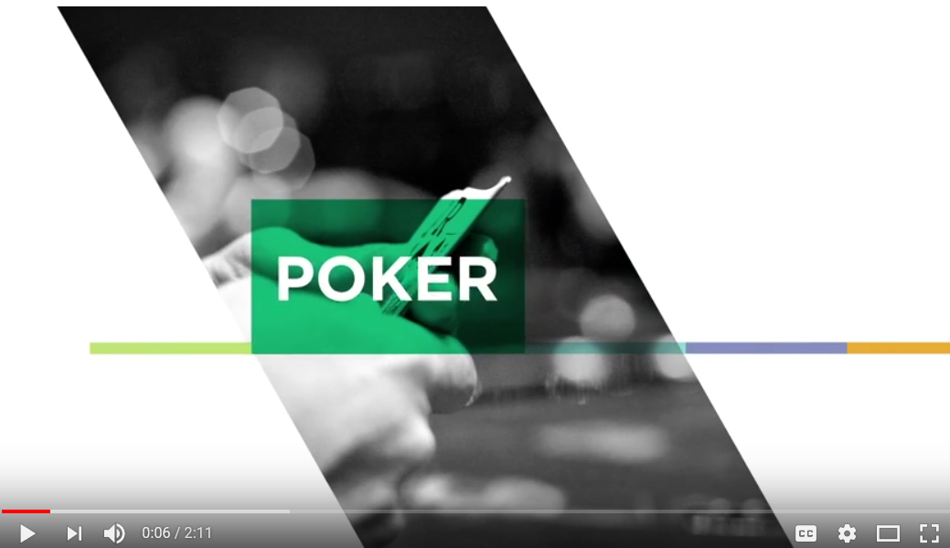
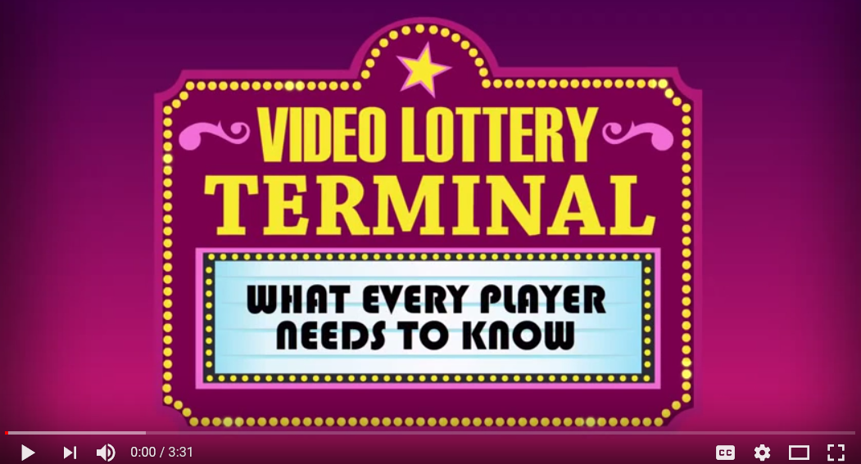
GAMBLING AMONG LOW INCOME ADULTS WITH COMPLEX NEEDS
Dispelling gambling myths
Notes:
It may be useful to dispel myths surrounding gambling games:
https://youtu.be/9TL0D5119DU
Understanding Poker – Loto Quebec
https://youtu.be/ZxMKhUMF-EE
Understanding how Video Lottery Terminals work – Loto Quebec

Slide 21
GAMBLING AMONG ADULTS EXPERIENCING POVERTY AND HOMELESSNESS
Exercise 4: Reflecting
Activity: Role Play
Show video of Andrew and Melinda role playing client and worker and demonstrating how to initiate a discussion about problem gambling.
What was effective about Melinda and Andrew’s demonstration? Is there anything else they could have done?
Notes:
What was effective about Melinda and Andrew’s demonstration? Is there anything else they could have done?

Slide 22
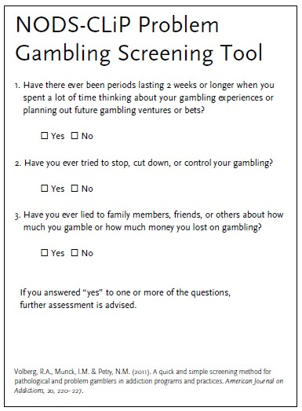
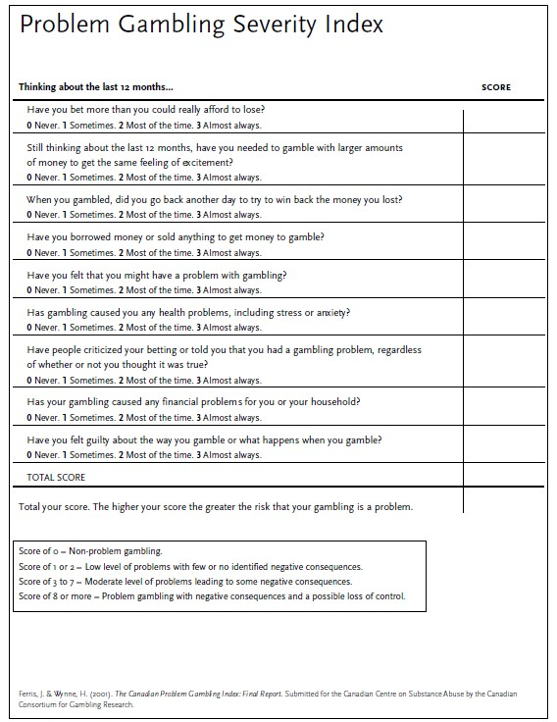
GAMBLING AMONG ADULTS EXPERIENCING POVERTY AND HOMELESSNESS
Screening for gambling problems
Notes:
Does your agency screen for gambling? If not there are screening tools available that may be useful to integrate into your agency’s intake screening process. Be mindful that the client may not present problem gambling at screening. Clients may disclose problem gambling behaviours at a later time after he/she feels more comfortable.
There are a number of screening tools that you can use to screen clients for gambling concerns. We are going to talk about two today: One is a very short screener called the NODS-CLiP, and the other is a screening tool developed in Canada called the Problem Gambling Severity Index. Both tools can be integrated with any standard screening already being done at your community agency.
A formal screening tool will help you and your client to get a better picture of their gambling.
The first screening tool is called the NODS-CLiP and it is a three-question screening instrument derived from the Diagnostic and Statistical Manual of Mental Disorders (DSM-IV). It is very effective in identifying people who may have gambling problems. You can ask the questions without using the tool as part of a conversation to determine if further screening or exploration of gambling is needed. If one or more of the three questions is answered with a yes, the person may have a problem with gambling. You can then explore their gambling further or consider using the second tool we are recommending, called the Problem Gambling Severity Index or PGSI.
The NODS-CliP is the shorter version of the full NODS.
The PGSI, developed in Canada, is an abbreviated version of the original tool called the Canadian Problem Gambling Index. It contains nine items rather than the original 31. It is more detailed than NODS-CLiP and includes instructions for scoring. The results will tell you if your client is a non-problem gambler, has a low or moderate level of gambling problems or is a problem gambler with negative consequences and a possible loss of control.
If your client has low to moderate levels of gambling problems, there is still work you can do. You could focus on increasing awareness by exploring consequences of gambling or support the client to track their play. You could explore triggers or help clients find ways to set limits. You could provide information to address mistaken beliefs about the games.
Both NODS CLiP and PGSI are based on DSM Criteria

Slide 23
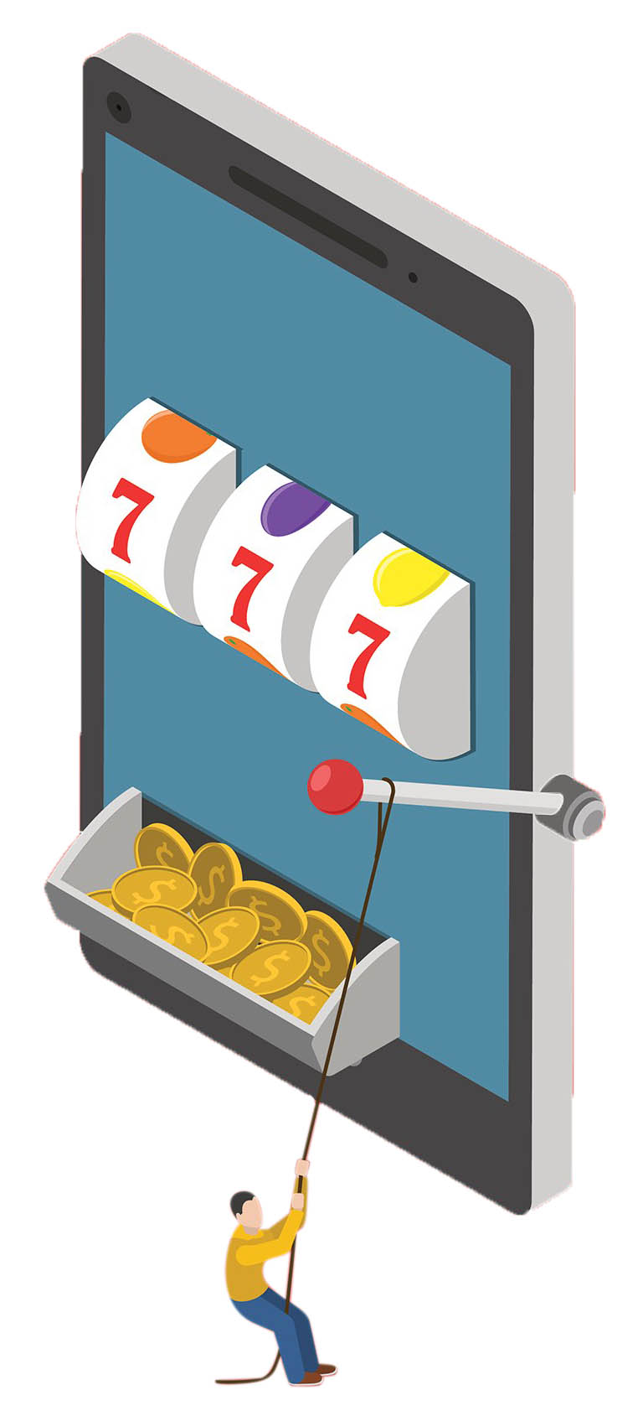
GAMBLING AMONG ADULTS EXPERIENCING POVERTY AND HOMELESSNESS
Gambling triggers
A trigger is something that makes someone want to
gamble.
Common gambling triggers include:
Having or needing money.
Unstructured time.
Access to gambling.
Mood fluctuations.
Social isolation.
Notes:
A trigger is something that makes someone want to gamble. Once you've screened your client and you've identified that he/she has gambling concerns you can help your clients identify triggers that urge gambling, and work with them to develop strategies to avoid them. One way to work towards this goal is to suggest that clients keep a journal to identify different situations where they felt the urge to gamble.
Common gambling triggers include:
Having or needing money - Both having money and needing money can be triggers for gambling and many people find it helpful to limit their access to money and change their attitudes about money in order to control their gambling. It may be useful to discuss ways to deal with money before payday or cheque day. A client can plan how they will use their money, how much if any they will spend on gambling and how they will resist urges to gamble more than they intend.
Unstructured time - Having free or unstructured time can be a strong trigger for gambling.
Access to gambling - Having easy access to their game of choice can be a trigger in itself.
Mood fluctuations - Both high and low mood can trigger gambling urges.
Social isolation - Loneliness and a desire to socialize can trigger urges to gamble.
The following is a list of more specific triggers taken from GREO’s Brian Connections: Problem Gambling series.
- Watching someone else engaging in your favourite form of gambling.
- Watching someone else engaging in a form of gambling you have never liked.
- Engaging in a form of gambling that has not caused a problem for you before.
- Listening to people talk about gambling wins.
- Opening your wallet and seeing a large amount of cash.
- Driving in the direction of your preferred gambling venue.
- Having a great day and feeling invincible
- Having a really bad day and feeling like you’ll never be in control of your life.
The good news is that staying in treatment and abstaining from gambling can lead to fewer urges and less sensitivity to gambling triggers.

Slide 24
GAMBLING AMONG ADULTS EXPERIENCING POVERTY AND HOMELESSNESS
Exercise 5: Avoiding gambling triggers
Developing strategies that minimize your client’s exposure to their gambling trigger.
Scenario 1: Your client lives around the corner from a convenience store which sells their favorite scratch tickets.
Scenario 2: Your client just received their social assistance cheque.
Scenario 3: Your client recently got laid off from their job and now has unstructured free time.
Scenario 4: Your client just split up from their partner and is very upset.
Notes:
Divide into 4 groups to develop strategies that minimize your client’s exposure to their gambling trigger based on the following scenario, (This activity depends on the number of participants present - if there isn’t enough participants you can have a collective brainstorming session).
Scenario 1: Your client lives around the corner from a convenience store which sells their favorite scratch tickets.
Scenario 2: Your client just received their social assistance cheque.
Scenario 3: Your client recently got laid off from their job and now has unstructured free time.
Scenario 4: Your client just split up from their partner and is very upset.

Slide 25

GAMBLING AMONG ADULTS EXPERIENCING POVERTY AND HOMELESSNESS
Concurrent disorders
Problem gambling frequently co-occurs with numerous other conditions including substance use, and affective disorders (such as depression).
When working with clients who struggle with one or more addictions, it is important to understand how one addiction may feed into another.
Notes:
Problem gambling frequently co-occurs or is comorbid with numerous other conditions including substance use, and affective disorders (such as depression).
When dealing with a client who may be experiencing comorbid disorders, it is important to encourage them to identify specific triggers for each disorder and try to identify ways in which triggers for one may act as a mutual trigger for the other. Research has identified that persons with problem gambling are more likely to seek treatment primarily for other comorbid conditions (such as depression and substance use), and have low self-awareness of their problem gambling which places more importance on the role of providers to screen for problematic behaviours.
Sometimes, when an individual stops or otherwise cuts back on one addictive behavior, they ‘compensate’ for this loss by initiating or intensifying another addictive behavior. This phenomenon called addiction transfer. When working with clients who struggle with one or more addictions, it important to keep track of how one addiction may feed into another, and educate clients about addiction transfer. One possible reason for this addiction transfer is a lack of proper coping mechanisms. That is, clients may move from one addiction to the next in an attempt to cope with a bigger, underlying issue (e.g., depression, trauma, or PTSD). Thus, if a gambler attempts to cut back on their gambling, they may begin to use substances more such as alcohol or nicotine.
Problem gambling rates among those who abuse substances like alcohol and other drugs are four to ten times that of the general population. There are similarities between pathological gambling and substance abuse, pointing to the common symptoms such as loss of control, disease progression, and even tolerance - it is common for pathological gamblers to require increasingly large bets in order to achieve the desired level of excitement and for drug users to develop tolerance requiring greater frequency, and higher doses to achieve a high. Unfortunately, many service providers see problem gambling as irrelevant or at least as secondary to substance addiction.
In a study investigating addiction transfer of 78 problem gambling patients, researchers found that men had higher rates of substance use disorders, whereas women scored higher on depression, anxiety, and eating disorders.

Slide 26
GAMBLING AMONG ADULTS EXPERIENCING POVERTY AND HOMELESSNESS
Quitting or cutting down on gambling
If a client wants to quit or cut back on gambling, you can help them explore:
If gambling is being used as a coping mechanism or as a substitute for other behaviours such as substance use.
If there are locations or situations that trigger their gambling.
Make a list of reasons not to gamble, or other activities the client enjoys that the client can refer to when he/she feels the urge to gamble.
Notes:
If a client wants to quit or cut back on gambling, as a service provider you can help them explore:
If gambling is being used as a coping mechanism or as a substitute for other behaviours such as substance use.
If there are locations or situations that trigger their gambling.
Why they are gambling
If the people that they hang around with gamble and how that affects them
If they are at higher risk when they get money
The various support options available in the community
Write down a list of things—including people and places—that makes the client want to gamble, and discuss ways the client can avoid them
Make a list of activities that the client enjoys that they can do instead of gambling
Make a list of reasons not to gamble that the client can refer to when they feel the urge to gamble

Slide 27
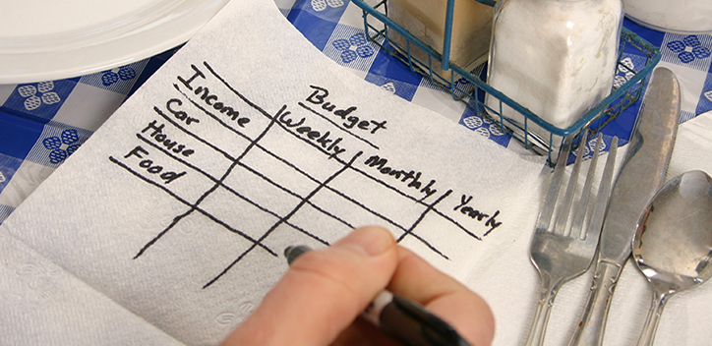
GAMBLING AMONG ADULTS EXPERIENCING POVERTY AND HOMELESSNESS
Safer gambling tips
Ask clients to consider:
Gambling less often, or taking breaks while gambling.
Setting time and money limits and setting a budget.
That gambling is not a way to make money.
Refraining from gambling when drinking or using substances.
Acknowledging that they will not win back past gambling losses.
Notes:
Clients who feel they are able to moderate their gambling can adopt strategies that will reduce the risk of developing a gambling problem or reduce the harm they are experiencing from their gambling. These are often referred to as harm reduction or responsible gambling strategies. The purpose of these strategies is to ensure clients are gambling consciously by asking them to reflect on situations, thoughts, and environments that encourage gambling.
Ask clients to consider to:
Gamble less often, or take breaks while gambling.
Make a daily schedule and stick to it, eliminate large portions of free time during the day.
Set time and money limits when gambling.
Track their spending and set a budget.
Only play specific games (avoiding games that cause them problems).
Decide what they will do with any winnings (to prevent them from gambling them away).
Pay for necessities before gambling.
See gambling as entertainment and not as a way to make money.
Refrain from gambling when drinking or using substances.
Not gamble with borrowed money from friends or payday loans.
Set times when they will not gamble (for example: when they feel sad).
Purchase items at convenience stores only once a week to avoid exposing themselves to lottery and scratch ticket.
If gambling online, using software programs that blocks or restrict access.
Acknowledge that they will not win back past gambling losses.

Slide 28
GAMBLING AMONG ADULTS EXPERIENCING POVERTY AND HOMELESSNESS
Quitting gambling
Abstinence is for clients who have tried to limit their gambling unsuccessfully, or who feel their gambling is out of control. It is the client's choice to pursue this option.
Help clients verbalize the negative impact of gambling.
Explore ways your client can find hope and meaning.
Once a client expresses desire of abstinence you can do the following:
Motivate them to be strong.
Show compassion and understanding.
Notes:
Abstinence is for clients who have tried to limit their gambling unsuccessfully, or who feel their gambling is out of control. It is the client's choice to pursue this option.
When interacting with a client who feels their gambling is out of control, you can:
Help clients verbalize the negative impact of gambling - Spend time analysing the positive and negative impact of gambling and let the client draw their own conclusions.
Explore ways your client can find hope and meaning - Clients experiencing poverty and homelessness may be enticed by the false hope that gambling provides. It’s important to help clients explore other sources of hope and meaning outside of gambling.
Once a client expresses desire of abstinence you can do the following:
Motivate them to be strong - If possible, encourage clients to draw inspiration from others who have had success overcoming their gambling concerns.
Show compassion and understanding - It’s important to understand that relapse is not uncommon with either moderation goals or abstinence. Relapse, however, does not mean that a client cannot recover. It’s necessary to emphasize to your clients that relapse isn’t a sign of failure and that gambling problems take time to change. The most significant thing is that you continue to offer assistance and support through any relapse.

Slide 29
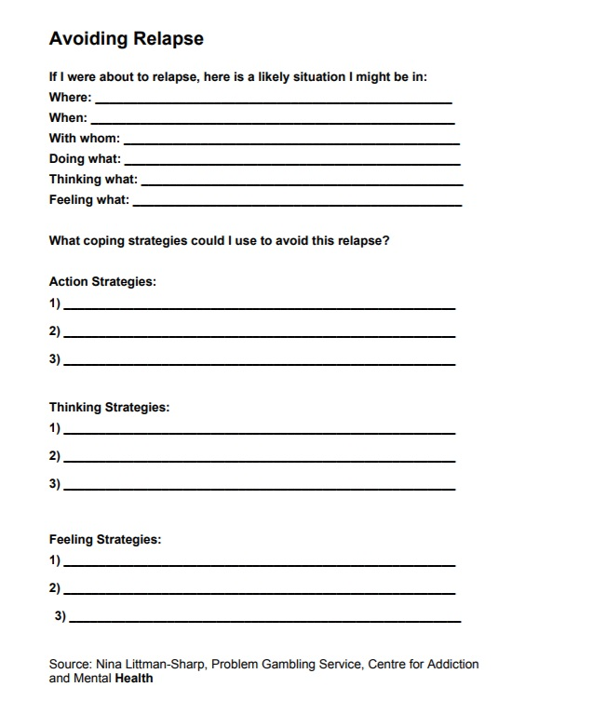
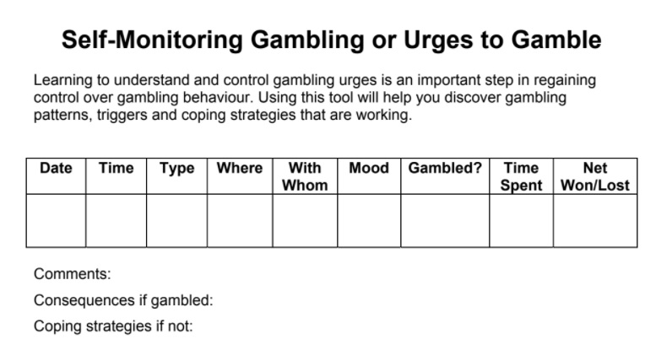
GAMBLING AMONG ADULTS EXPERIENCING POVERTY AND HOMELESSNESS
Gambling self-monitoring and avoiding relapse
Notes:
Self-Monitoring Gambling or Urges to Gamble and Avoiding Relapse worksheets are both useful ways for clients to understand and control their gambling behavior. These tools provide an opportunity for clients to reflect on their gambling urges as they happen and come up with strategies to avoid relapse that can be shared and discussed with case workers.

Slide 30
GAMBLING AMONG ADULTS EXPERIENCING POVERTY AND HOMELESSNESS
Treatment modalities
Some common forms of treatment for problem gambling include:
Psychosocial Treatments and Therapies.
Mutual Aid.
Pharmacological Treatment.
Notes:
Some common forms of treatment for problem gambling include:
Psychosocial Treatments and Therapies.
Mutual Aid.
Pharmacological Treatment.
Problem gambling treatment services are available throughout Canada. For a list of locations go to the Ontario Problem Gambling Helpline (number and website listed at the end of the module).
Assessment for problem gambling is important and should be done early, as treatment outcomes may differ depending on the severity of the problem gambling.
No single approach has proven to be most effective in treating problem gambling. Individual factors may play a role in treatment success and recovery. A good rapport between client and therapist is a strong predictor of treatment success.
From: Prevention and treatment of problem gambling among older adults: a scoping review
Psychosocial Treatments and Therapies encompass...
Cognitive behavioural therapy: CBT is a practical, short-term form of psychotherapy. It helps people to develop skills and strategies for becoming and staying healthy. Cognitive behavioural treatments for problem gambling have considerable support for their effectiveness.
Mindfulness, Motivational Interviewing (MI) and Exercise: Mindfulness-based interventions expand upon the CBT tradition by incorporating approaches to the mind and body within a cognitive-behavioural framework. Counseling using motivational techniques has the possibility of inducing better treatment engagement. Physical exercise, which is associated with both mindfulness and motivation, can lead to decreases in craving, depression and anxiety.
Treatment that Integrates Support from Family and Loved Ones: If your client is in a relationship, it is important to understand that gambling concerns may be a component of that relationship, and that recovery will require the involvement of both partners. Interventions may include psycho-education, accessing community resources, counselling services and family member involvement. Individuals, particularly older adults, may see gambling as a social activity that allows them to spend time with others. Social support may bolster treatment and enhance recovery from PG.
Group Therapy: Given that many individuals with gambling concerns report feelings of loneliness, group based therapy may substitute for the social interaction that they experience while gambling.
Online Treatment Options: Can include Gamaid, Telehealth, and online CBT interventions. Advantages to online treatment options include convenience particularly for those with mobility concerns, affordability, and the ability to avoid shame and embarrassment.
Mutual Aid
Mutual aid based therapy for gambling problems is typically rooted in Gamblers Anonymous (GA) and other 12 Step treatment programs. Attendance and social support within these groups were the best predictors of achieving abstinence. Research has suggested that GA may be more effective in combination with other treatment modalities.
(Gamblers Anonymous is a mutual-aid group, similar in principles and philosophy to Alcoholics Anonymous, following a disease model of addiction with lifelong total abstinence needed for recovery from "Compulsive Gambling". It offers support to people affected by gambling problems. GA's belief is that "compulsive gamblers" have a progressive illness, which can be arrested, but never cured.)
Pharmacological Treatment
Pharmacological treatments are promising and may elicit a response from some individuals who suffer from PG. Impulse Control Disorders and Obsessive Compulsive Disorder are typically treated using antidepressants, mood-stabilizers, opioid agonists, atypical neuroleptics, and glutamatergic agents.

Slide 31
GAMBLING AMONG ADULTS EXPERIENCING POVERTY AND HOMELESSNESS
There is hope
When your client is ready to talk about their gambling, it is encouraging to remember that:
Gambling problems can be successfully treated.
Seeking help for a problem is not a sign of weakness.
The sooner the problem is addressed, the easier it is to overcome.
Continue to offer assistance and support through any relapse.
Notes:
When your client is ready to talk about their gambling, it is encouraging to remember that:
Gambling problems can be successfully treated.
Seeking help for a problem is not a sign of weakness.
The sooner the problem is addressed, the easier it is to overcome.
Continue to offer assistance and support through any relapse.

Slide 32
GAMBLING AMONG ADULTS EXPERIENCING POVERTY AND HOMELESSNESS
Closing message
Notes:
Play video from 0:00 – 0:00

Slide 33
GAMBLING AMONG ADULTS EXPERIENCING POVERTY AND HOMELESSNESS
Resources
CAMH’s Adolescent Clinical and Educational Services (ACES) – (416) 535 8501 ext. 1730
CAMH’s Problem Gambling Service – 1 (888) 647 4414 or www.problemgambling.ca
Distress Centre Ontario – www.dcontario.org
Gamblers Anonymous – (855) 222 5542 or www.gamblersanonymoustoronto.org
Good Shepherd Ministries Gambling Addiction Program – (416) 869 3619 ext. 245 or 260 or www.goodshepherd.ca
Problem Gambling Helpline – 1 (888) 230 3505 or www.problemgamblinghelpline.ca
The Jean Tweed Centre for Women and Their Families – (416) 225 7359
The YMCA Youth Gambling Awareness Program – www.youthbet.com

Slide 34
GAMBLING AMONG ADULTS EXPERIENCING POVERTY AND HOMELESSNESS
References
Baxter, A., Salmon, C., Dufresne, K., Carasco-Lee, A., Matheson, F.I. 2016. Gender differences in felt stigma and barriers to help-seeking for problem gambling. Addictive Behaviours Reports 3
Brain Connections: Understanding Problem Gambling. Gambling Research Exchange Ontario. Retrieved from: brainconnections.ca
CAMH – Primary Addiction Toolkit – Problem Gambling. Retrieved from https://www.porticonetwork.ca/web/problem-gambling-toolkit/introduction
Gambling in the Veterans Affairs Context: an Educational Toolkit for Case Managers and Health Professionals. Gambling
Research Exchange Ontario
Ferentzy, P., Wayne Skinner W.J., Matheson, F.I. Illicit Drug Use and Problem Gambling. 2013. ISRN Addiction
Guilcher, S.J.T., Hamilton-Wright, S., Skinner, W., Woodhall-Melnik, J., Ferentzy, P., Wendaferew, A., Hwang, S.W., Matheson, F.I. 2016. Talk with me: perspectives on services for men with problem gambling and housing instability. BMC Health Services Research 16(340)
Hamilton-Wright, S., Woodhall-Melnik, J., Guilcher, S.J.T., Schuler, A., Wendaferew, A., Hwang, S.W., Matheson, F.I. 2016. Gambling in the landscape of adversity in youth: Reflections from men who live with poverty and homelessness. International Journal of Environmental Research and Public Health 13(854).
Kryszajtys, D., Matheson, F.I. Problem gambling and crime and its costs. Gambling Research Exchange Ontario.
Prevention and treatment of problem gambling among older adults: a scoping review (2017). Ferentzy P., Sztainert, T., Lakman Y., Steele S,J., Ziegler C,P., Matheson F,I.
Problem gambling: A guide for helping people experiencing poverty. Problem Gambling Institute of Ontario. Retrieved from: www.problemgambling.ca/EN/ResourcesForProfessionals/PublishingImages/handbook-poverty-homelessness-accessible-2017.pdf
Problem gambling: A guide for parents. Problem Gambling Institute of Ontario. Retrieved from: www.problemgambling.ca/EN/Documents/Problem_Gambling_A_Guide_for_Parents.pdf
YMCA Youth Gambling Awareness Program (YGAP). Retrieved from: www.youthbet.com/
Youth and gambling: Treatment considerations and recommendations. Problem Gambling Institute of Ontario. Retrieved from: www.problemgambling.ca/EN/ResourcesForProfessionals/Pages/YouthAndGamblingTreatmentConsiderationsandRecommendations.aspx
Notes:
Image and Video References
Slide 5: https://pbmo.files.wordpress.com/2012/07/problem-gambling.png?w=300&h=300
Slide 6: http://prod.static9.net.au/_/media/Network/Images/2017/03/16/14/22/170316coach_sleepwalking.jpg
Slide 8: Inside the brain of a gambling addict - BBC https://youtu.be/BF5SzIN63w8
Slide 9: https://pbs.twimg.com/media/DHwAceeWAAEJ4i9.jpg
Slide 13: https://www.mobileslots4u.co.uk/wp-content/themes/mobileslots/images/scratch-cards.gif
Slide 14: http://nj1015.com/files/2012/03/gambler.jpg
Slide 15: https://www.youtube.com/watch?v=VlyqCn-OpmE&list=PLsnJJTyXnkJ-UHqZzlsUL6Ip8TDA98gA2&index=2 YGAP - PG Stigma
Slide 16: https://f66425a2f1-custmedia.vresp.com/8468edf2e7/talk.gif
Slide 18: http://www.smartrecovery.org/images/gambling.jpg
Slide 20: https://youtu.be/9TL0D5119DU - Understanding Poker – Loto Quebec
https://youtu.be/ZxMKhUMF-EE - Understanding how Video Lottery Terminals work – Loto Quebec
Slide 23: https://media.wired.com/photos/59267b22cfe0d93c474305b0/master/w_2596,c_limit/russian-slot-machine-479603952.jpg
Slide 25: https://www.thefix.com/sites/default/files/styles/article/public/changingaddiction.jpg
Slide 27: https://i1.wp.com/www.threesixtyfinance.com/wp-content/uploads/2017/05/budget.jpg?resize=900%2C480

