Slide 1
Launch of the SPRinG App - A digital health solution to support self-management of problem gambling
Thursday June 23rd 1:00 to 2:00 p.m.
Dr. Flora Matheson
Dr. Arthur McLuhan
Madison Ford

Slide 2
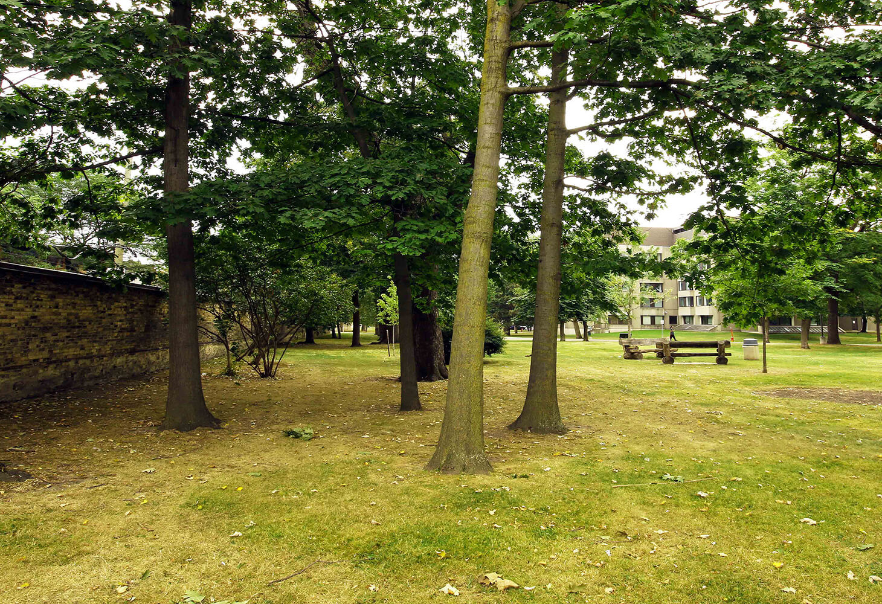
CAMH Land Acknowledgement
CAMH is situated on lands that have been occupied by First Nations for millennia; lands rich in civilizations with knowledge of medicine, architecture, technology, and extensive trade routes throughout the Americas. In 1860, the site of CAMH appeared in the Colonial Records Office of the British Crown as the council grounds of the Mississaugas of the New Credit, as they were known at the time.
Today, Toronto is covered by the Toronto Purchase, Treaty No. 13 of 1805 with the Mississaugas of the Credit.
Toronto is now home to a vast diversity of First Nations, Inuit and Métis who enrich this city.
CAMH is committed to reconciliation. We will honour the land through programs and places that reflect and respect its heritage. We will embrace the healing traditions of the Ancestors, and weave them into our caring practices. We will create new relationships and partnerships with First Nations, Inuit and Métis – share the land and protect it for future generations.
Reference: https://www.camh.ca/en/driving-change/building-the-mental-health-facility-of-the-future

Slide 3
Language
CAMH places equity, diversity and inclusion (EDI) at the centre of our work. We understand that language is constantly evolving as societal and cultural values change. We strive to use language that celebrates the diversity of the communities we serve and remains respectful, inclusive and free of bias. As part of our commitment to EDI, we welcome feedback on our language use and routinely review our content, updating the language as needed.

Slide 4
About GGTU
The Gambling, Gaming and Technology Use (GGTU) program is part of the Knowledge Exchange and Training portfolio in CAMH’s Provincial System Support Program. GGTU aims to build a stronger mental health and addictions system in Ontario by supporting addictions and mental health service providers through training and education, digital tools and resources, and knowledge sharing activities.
Notes:
Anita

Slide 5
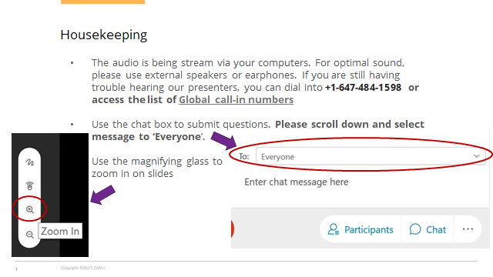
Housekeeping
The audio is being streamed through your computer speakers. For the best sound, use external speakers or earphones.
If you’re having difficulty hearing our presenters, please dial +1-647-484-1598 or access the list of Global call-in numbers.
Use the chat panel to submit your questions. Please scroll down and select “Everyone”.
Use the magnifying glass to zoon in on the slides.
Notes:
The audio is being broadcasted through your computers. If you are having any difficulty hearing the presenters, you can dial in or have the system call you by following the information you received in your registration confirmation email or your webinar reminder email.
All participants are muted today with webcams disabled. Questions for the speakers can be typed in the chat box and will be reserved for the Q&A period at the end of the webinar. Please address your questions to ‘Everyone’ or to ‘the host’ if you’d like to ask the question anonymously.
To zoom in on slides, you can use the small magnifying glass icon on the left hand side of your screen.

Slide 6
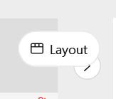
Housekeeping
You can change the presenter layouts so you can
see all panelist, or just the active speaker
This webinar will be recorded and will be posted on the www.eenet.ca after the presentation. You will receive an email with the link.
We would appreciate having your feedback on today’s webinar. Your browser will switch to the survey after this webinar ends. Thanks in advance for the 2 minutes of your time to complete our online feedback survey!
Notes:
In the top right corner of your screen you will find a control panel that lets you change how you view the speakers and presentation.
We will monitor the question box and ask the presenters your questions at the end of all the presentations.
This webinar will be recorded and posted on eenet.ca following the presentation, and the recording link will be emailed to all webinar registrants.
Finally, we would appreciate having your feedback on today’s webinar. An online survey will appear on your browser at the end of the webinar that will take less than 5 minutes of your time to complete.

Slide 7


Flora Matheson
Dr. Flora Matheson leads the Justice and Equity Research Program located at MAP Centre for Urban Health Solutions, St. Michael’s Hospital. Her research focuses on solutions to reduce social and health inequities among people experiencing problem gambling and imprisonment; solutions that are built with and for these communities. As a Sociologist she uses both a gender and social determinants of health lens to enact change.

Slide 8
Arthur McLuhan
Dr. Arthur McLuhan is a postdoctoral fellow at MAP Centre for Urban Health Solutions, St. Michael’s Hospital, Toronto. A sociologist of culture and interaction, his research examines the interactional patterns that sustain group affiliations, shape identities, maintain boundaries, and reproduce inequalities. He uses qualitative methods to study these issues across a variety of groups and social settings. His postdoctoral research is focused in two areas: (1) problem gambling, poverty, and homelessness and (2) incarceration, re-entry, and health.

Slide 9
Madison Ford
Madison Ford is a Research Coordinator in the Justice and Equity Research Program within the MAP Centre for Urban Health Solutions, St. Michael's Hospital. She holds a Master’s of Public Health from Lund University and focused her thesis research on the association between problem gambling and comorbid physical conditions, mental health problems, problematic substance use, and behavioural addictions with the goal of finding new opportunities for pathways to treatment. As a Research Coordinator, she is currently managing various projects, including a self-management app for people experiencing problem gambling.

Slide 10



Learning Objectives
1) To understand the challenges of problem gambling recovery, including barriers to care, service access, and support for problem gambling, in the context of poverty and homelessness.
2) To review our approach to self-management and digital health solutions to address current problem gambling needs, such as services gaps in Ontario/Canada.
3) To learn about our digital health self-management solution for problem gambling support and recovery—the Spring App.

Slide 11

To understand the challenges of problem gambling recovery, including barriers to care, service access, and support for problem gambling, in the context of poverty and homelessness.
Objective 1

Slide 12
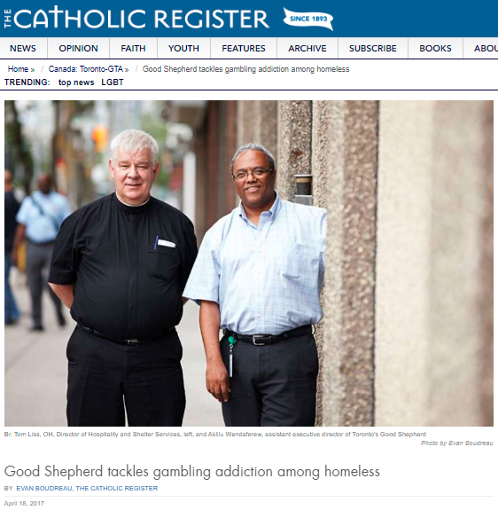
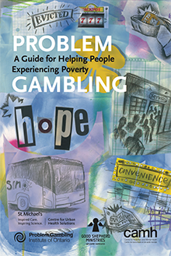

Background

Slide 13
Problem Gambling, Poverty and Homelessness
Problem gambling, poverty and homelessness are interconnected and present as hidden public health problems
  Problem gambling is often linked with other complex health challenges such as childhood and adult trauma, mental illness and substance use (Cowlishaw et al., 2014, Ferentzy et al., 2013, Matheson et al., 2014, Roberts et al., 2017)
Prevalence of problem gambling is much higher for people experiencing poverty/homelessness
  Rate of 5-6 times higher than general population (men: 35%; women: 28%) vs. about 3-8% (Matheson et al., 2014, 2021)

Slide 14
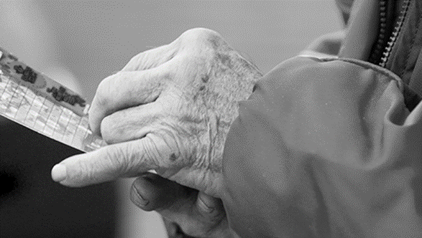
Problem Gambling, Poverty and Homelessness
Gambling problems are associated with several poverty measures including unemployment, precarious employment, precarious housing, homelessness, and low income (Matheson et al., 2014)
At an area-level, neighborhood disadvantage is associated with higher prevalence of gambling problems (Hahmann et al., 2021)
A person of low income living in an area of higher disadvantage has an elevated risk of gambling problems (Hahmann et al., 2021)

Slide 15
Service Landscape
Long waitlists
Stigma
Service desert
Lack of funding
Siloed services
‘‘I don’t want to talk to anybody about it.
I’m ashamed of it’’
“almost all of my clients . . . have more than one issue. I mean, not only are they all in poverty and they all have gambling issues, but some of them have mental health issues . . . a lot of them have family conflict, a lot of them are unemployed or have a disability of some kind. So to just treat the gambling would be to not treat the whole person.”
(Guilcher et al., 2016, 2020, Woodhall-Melnik et al., 2019)

Slide 16
To review our approach to self-management and digital health solutions to address current problem gambling needs, such as services gaps in Ontario/Canada.
Objective 2

Slide 17
Self-Management and Problem Gambling
Are there other, more accessible ways to support people experiencing gambling problems, particularly in the context of poverty and homelessness?
Self-management approaches
  A growing area of health research and practice across a variety of conditions
  An option for supporting people experiencing PG

Slide 18
Self-Management and Problem Gambling
Self-management refers to “an individual’s ability to manage the symptoms, treatment, physical and psychosocial consequences and lifestyle changes inherent in living with a chronic condition. Efficacious self-management encompasses the ability to monitor one’s condition and to affect the cognitive, behavioural and emotional responses necessary to maintain a satisfactory quality of life” (Barlow et al., 2002)

Slide 19
Self-Management and Problem Gambling
Self-management approaches can be:
  Informal efforts (e.g., an individual’s exercise regimen)
  Formal interventions (e.g., evidence-based programs for self-managing chronic conditions)
  Combination of informal and formal (e.g., ad hoc adjustments to formal interventions, tailoring them to individual circumstances) (Audulv et al., 2019)
Self-management for chronic health conditions has gained momentum as an important complement to clinical care (Barlow et al., 2002; Barrio et al., 2017; Gainsbury & Blaszczynski, 2011; Hulton et al., 2017; Lorig & Holman, 2003)
Self-management interventions may be effective interventions for drug, alcohol and behavioural addictions (Barrio et al., 2017; Sakakibara et al., 2017; Akın et al., 2015)

Slide 20

Self-Management and Problem Gambling
Self-management approaches align with participants’ treatment needs and preferences
  Men experiencing PG prefer to be active participants in their own care plans through self-management strategies (Guilcher et al., 2016)
People who experience PG need access to treatment resources in high-risk situations, such as at night, on weekends, and during the holidays (Sanchez et al., 2019, van der Maas et al., 2019)

Slide 21
Self-Management and Problem Gambling
5 common self-management strategies in people experiencing poverty and homelessness (Matheson et al., 2021):
  seeking information on problem gambling
  talking about gambling problems
  limiting money spent on gambling
  avoiding gambling providers
  engaging in alternative activities
“sometimes I make my house…a mess. If I’m in it, I can make a big mess: ‘‘Oh, why did you do this?’’ But then I have to put everything back…I’m focused on what I’m doing, so other things won’t come to my mind. Because [when] I’m sitting the sofa, I have to think about what am I going to do, and I’m scared what’s going to come to my mind to do. So, this way I’m occupied with something that is healthy, something that makes you feel like good like putting your clothes away, doing the laundry. I do everything by hand, so it takes longer, so I’m busier. If I put it in the machine it’s faster. In the meantime, while the machine is going, I can go to the store and get a scratch ticket, this and that. If I do laundry at home, scrub, I mean I’m there swish-swish, then I don’t have time to think about that”

Slide 22
Self-Management and Problem Gambling
Generic self-management strategies:
  Self-management strategies are relatively generic across different populations (Brown & Newby-Clark, 2005; Matheson et al., 2019; Moore et al., 2012; Shaffer, 2005)
But context matters:
  Specific contexts may increase the complexity and difficulty of gambling self-management for particular populations
  Self-management strategies are shaped by social, financial, housing, and health challenges in important ways (Matheson et al., 2021)
“Every corner store [is tempting], but especially because I take a medication every day, I have to go to the pharmacy, so I’m right there, is the thing. So I have to like try to jet out of there not to buy one, you know, so yeah, it’s pretty hard, right. And at the subway they got those little lotto things downstairs and it’s like ‘‘Oh, just don’t do it, don’t do it,’’ and then I, well I already have it in my hand going up the stairs—and I don’t even realize I’ve done it sometimes. Yeah, so it’s just like drinking. When you just don’t realize, you know, you’ve started drinking already.”

Slide 23
Self-Management and Problem Gambling
Self-management may be an effective alternative or complement to formal PG treatment (Matheson et al., 2018; Matheson et al., 2019)
People experiencing PG indicate that self-management is an important element of treatment, including the use of technology (e.g., smartphone apps) in self-managing care (Guilcher et al., 2016; Matheson et al., 2019)
Self-management supports optimal care when tailored to person-specific cultures and contexts (Huang et al., 2020; Pinnock et al., 2017) including particular ethnic minority populations, youth, older men and women and those living in poverty (Matheson et al., 2018; Matheson et al., 2019; Kryszajtys et al., 2018)

Slide 24
Mobile Health Apps for Self-Management
Innovation and development of smartphone technologies created new opportunities for developing, delivering, and accessing addiction, relapse, and recovery supports (Savic et al., 2013)
mHealth apps offer low-barrier resources that enhance the accessibility, appeal, and adoption of self-management interventions (BinDhim et al., 2018; Verbiest et al., 2018; Volkova et al., 2016; Linardon et al., 2020)
mHealth app interventions providing accessible self-management supports have great potential given existing barriers to access PG services and low rates of treatment-seeking among people who experience PG (Loy et al., 2018; Hamilton Wright et al., 2019)

Slide 25
SPRinG App Foundational Elements
Gambling Addiction Program
Informed by evidence-based interventions for homeless persons, many of whom experience overlapping comorbidities and social complexities
Self-Management Approaches
Self-monitoring and disrupting gambling habits to effect positive behaviour change
Culture and Context
Attending to PG in the context of poverty, homelessness, and related health and social challenges
Gambling within the context of poverty requires a unique treatment space
Program included CBT, Life Skills, and Case Management elements
Becoming active participants in one’s own recovery and care
Leveraging the tracking and pattern recognition strengths of mHealth technologies
Low-barrier adjunct or alternative to formal PG treatment
Notes:
NOTE TO MADISON: do 1. GAP (what you have already), 2. Self Management Approaches (self-monitoring and disrupting gambling habits to effect positive behaviour change; as a low-barrier adjunct or alternative to formal PG treatment; becoming active participants in one’s own recovery and care; leveraging the tracking and pattern recognition strengths of mHealth technologies), 3. Culture and Context (attending to PG in the context of poverty, homelessness, and related health and social challenges)
The lit – sm paper just sent
The GAP – other paper, description of the gap, the CBT, the journaling
Journaling grounded in CBT –
Sensitive to population in both papers – example of this (in flora’s section)
Features and content sensitive to population

Slide 26
Mobile Health Apps for Self-Management
Few examples of PG-focused mHealth apps in the app marketplace, and fewer still, studied and published in the research literature (Pfund et al., 2019; So et al., 2020; Humphrey et al., 2020; Coral et al., 2020)
Although mHealth apps hold great potential to reduce barriers to PG services, high rates of attrition have limited their promise as tools in the effort to improve and maintain health (Naslund et al., 2015)
Assessing app feasibility is critical to the overall impact of mHealth interventions, informing future design, development, and implementation (Naslund et al., 2015)

Slide 27
To learn about our digital health self-management solution for problem gambling support and recovery—the Spring App.
Objective 3

Slide 28
The Solution: SPRinG
The SPRinG app is a self-help tool that is designed to be inclusive for all potential app users and aims to remove barriers to care
The app was designed in collaboration with community partners to ensure the UX design and content of the app were sensitive to the context of people experiencing homelessness
Continuous feedback from experts including service providers and people with lived experience
Co-design process allowed us to triangulate data and prioritize the features and functionality

Slide 29
SPRinG App Community Partners
Gamblers Anonymous
Public Health Ontario
GREO
Jean Tweed Centre
Fred Victor
Responsible Gambling Council
Good Shepherd Ministries
Centre for Addiction and Mental Health
COSTI
ConnexOntario

Slide 30
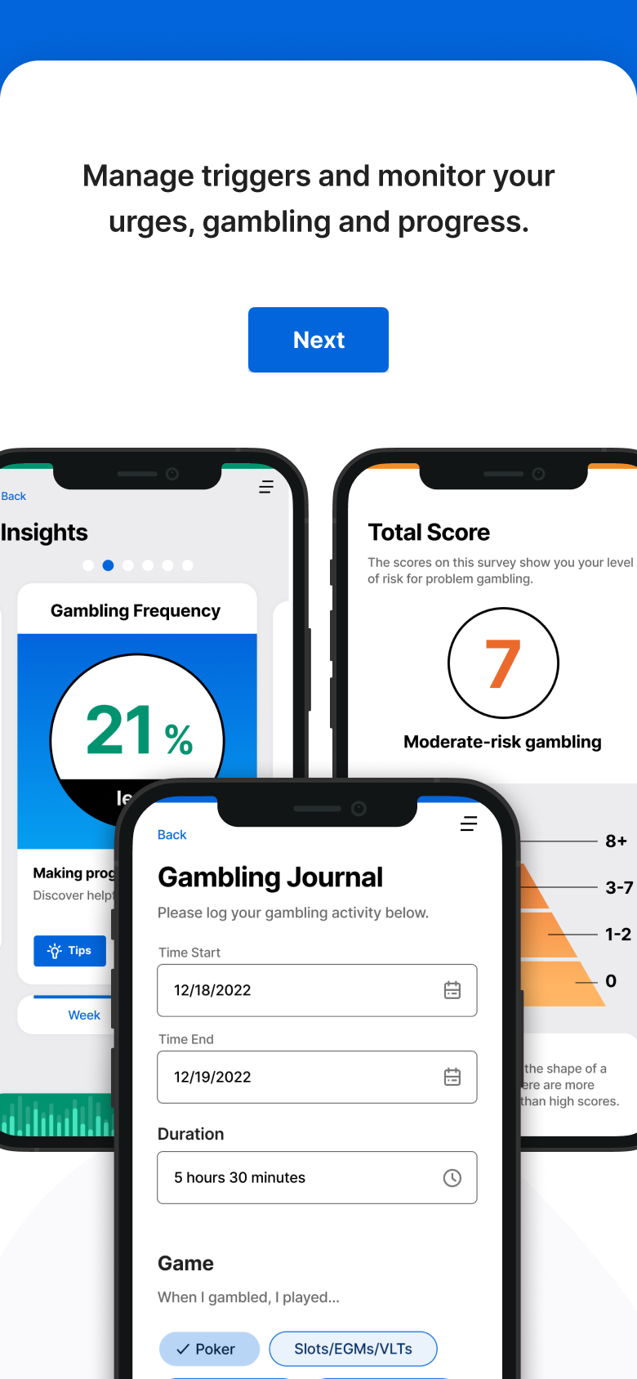
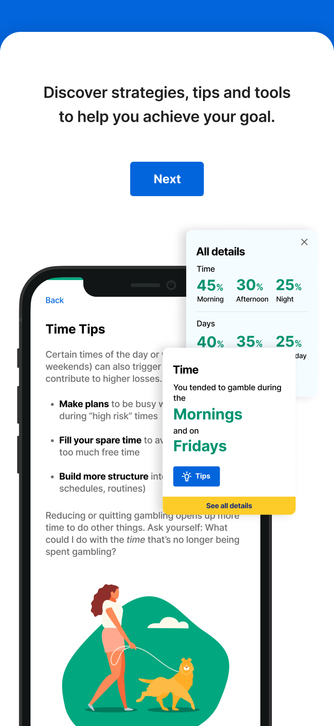
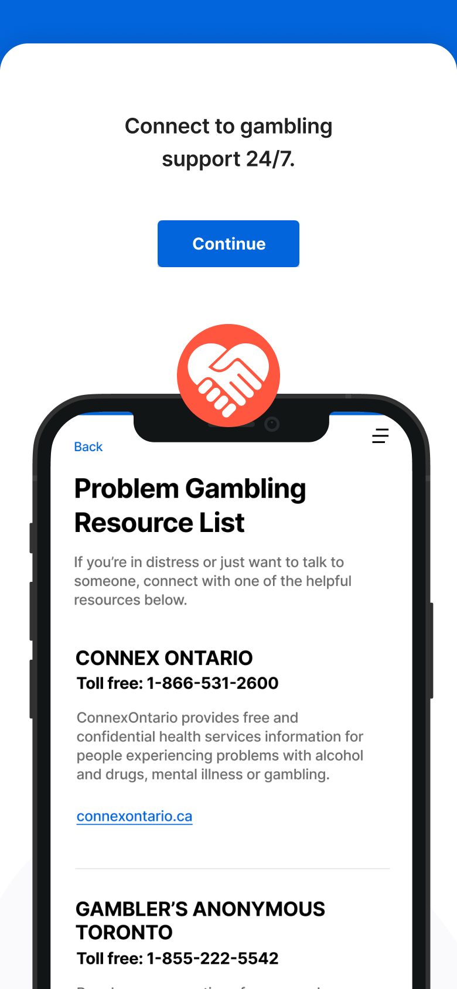
SPRinG:
App Tour

Slide 31
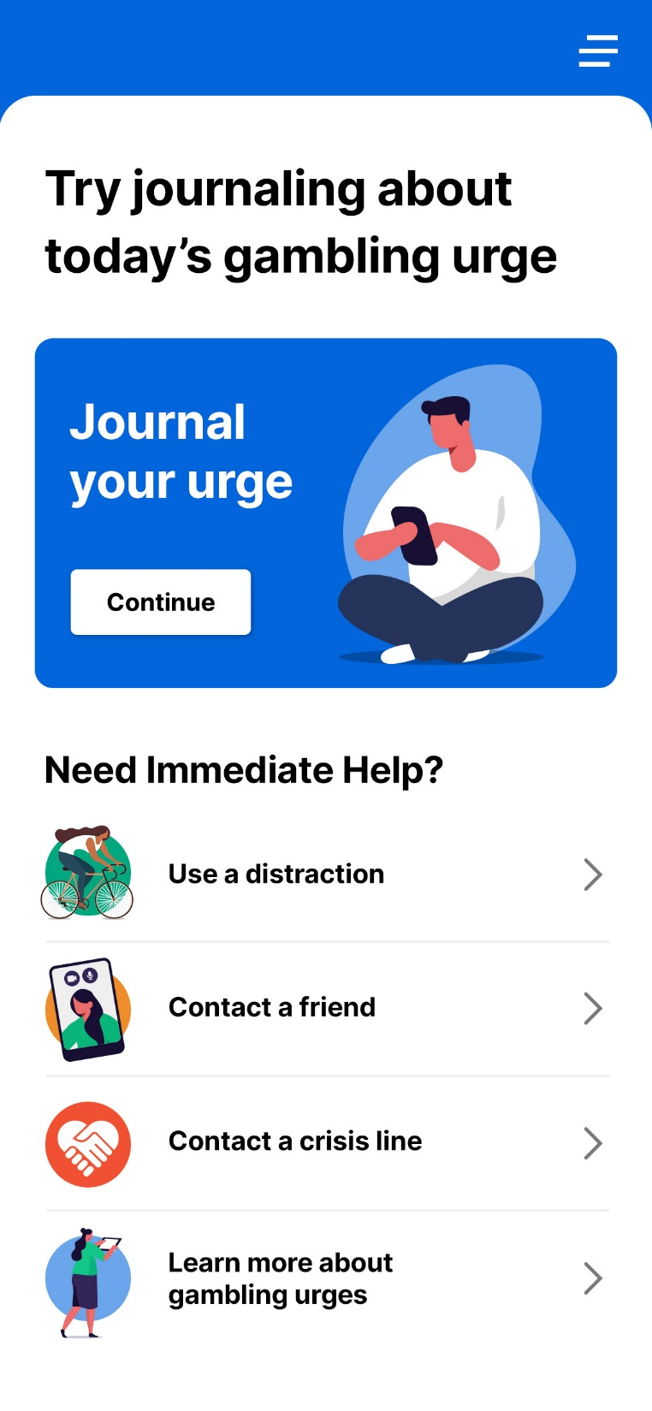
SPRinG: Urge Troubleshooting
When individuals are experiencing an urge they are provided with four troubleshooting options to deter them from gambling:
  Distractions/Alternate activities
  Contact a friend
  Contact a crisis line
  Learn about strategies
Notes:
Include subtle ways in the content

Slide 32
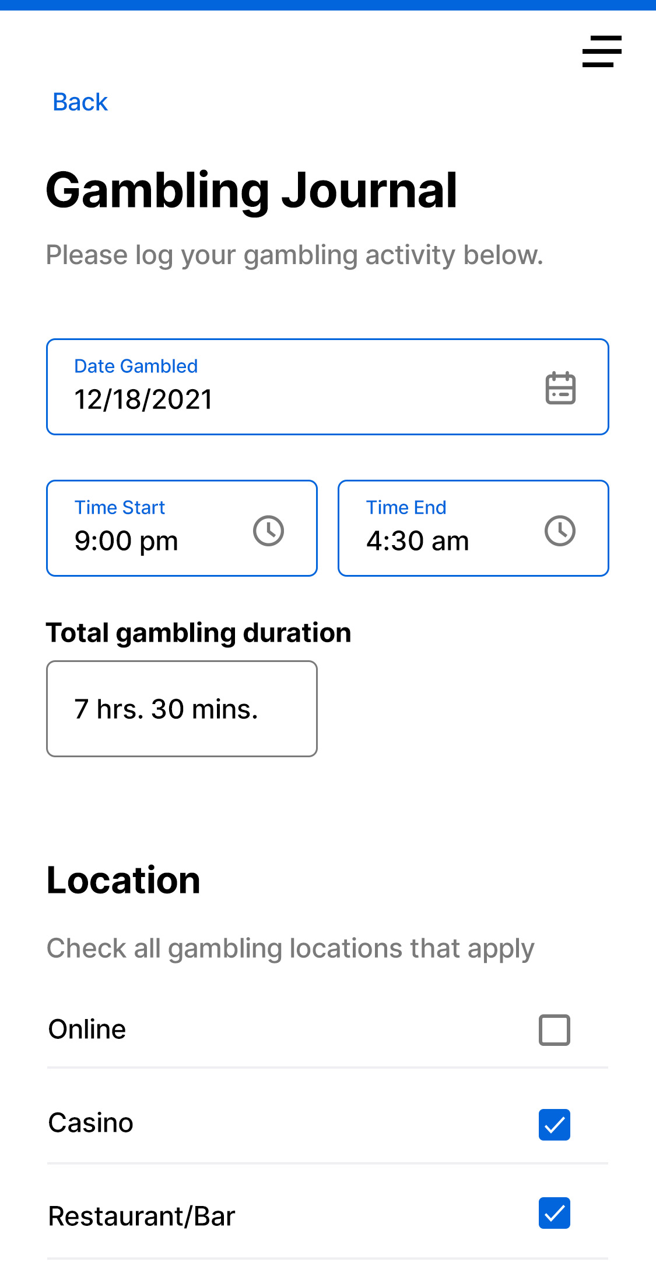
SPRinG: Journaling
Recording urges will help to identify triggers and high-risk situations and develop targeted strategies for managing urges to gamble
Understanding patterns in variables related to gambling events will help individuals learn strategies for limiting their gambling and/or reducing its harms

Slide 33
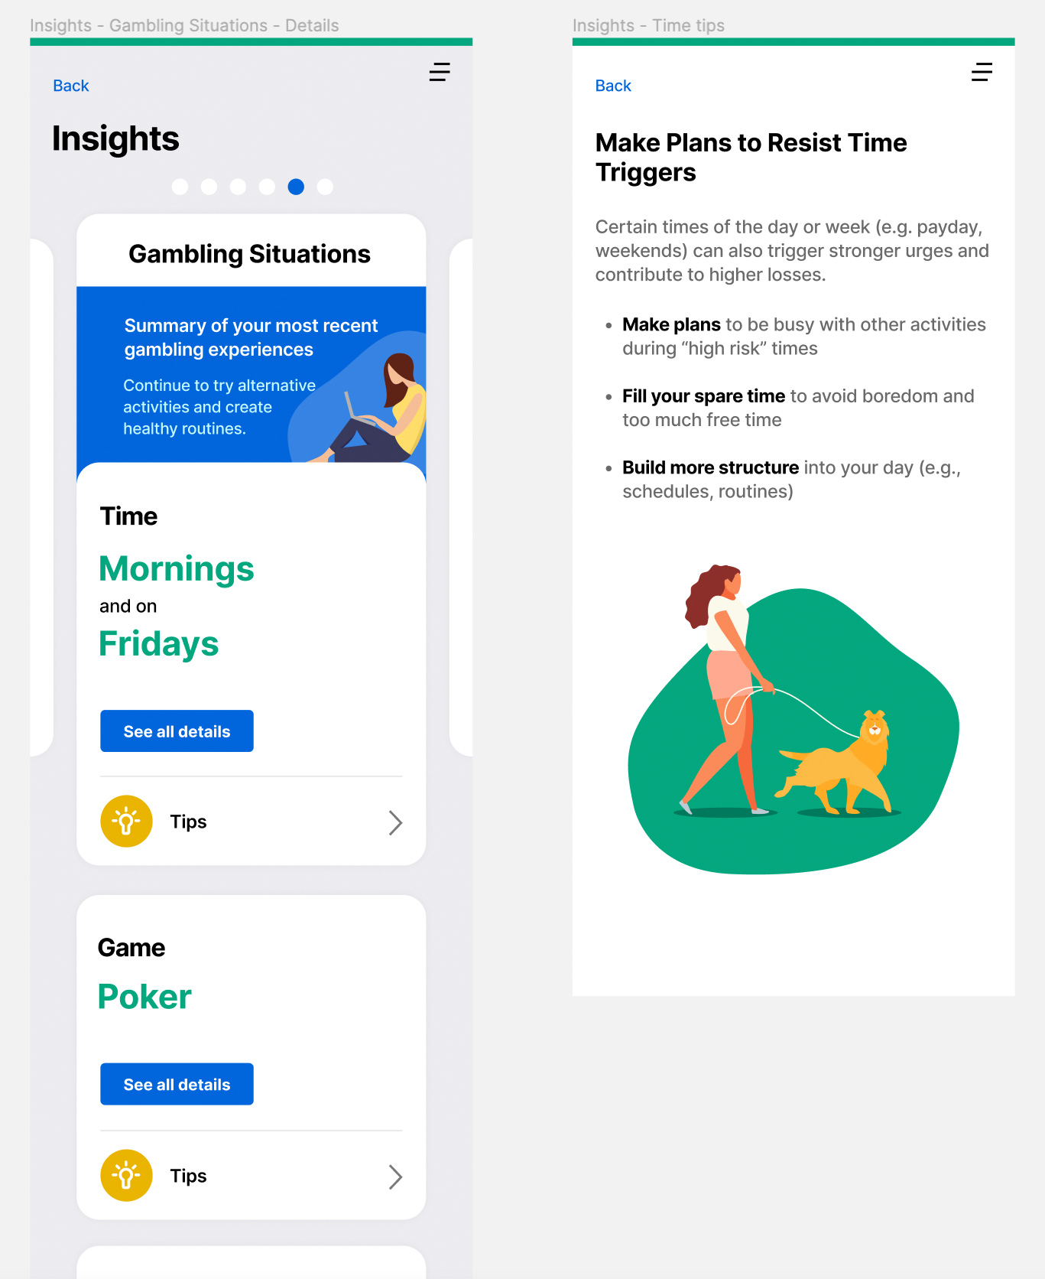
SPRinG: Insights
View patterns in their urge and gambling experiences
  Urge frequency
  Urge intensity
  Gambling frequency
  Gambling losses
  Urge and gambling situations

Slide 34
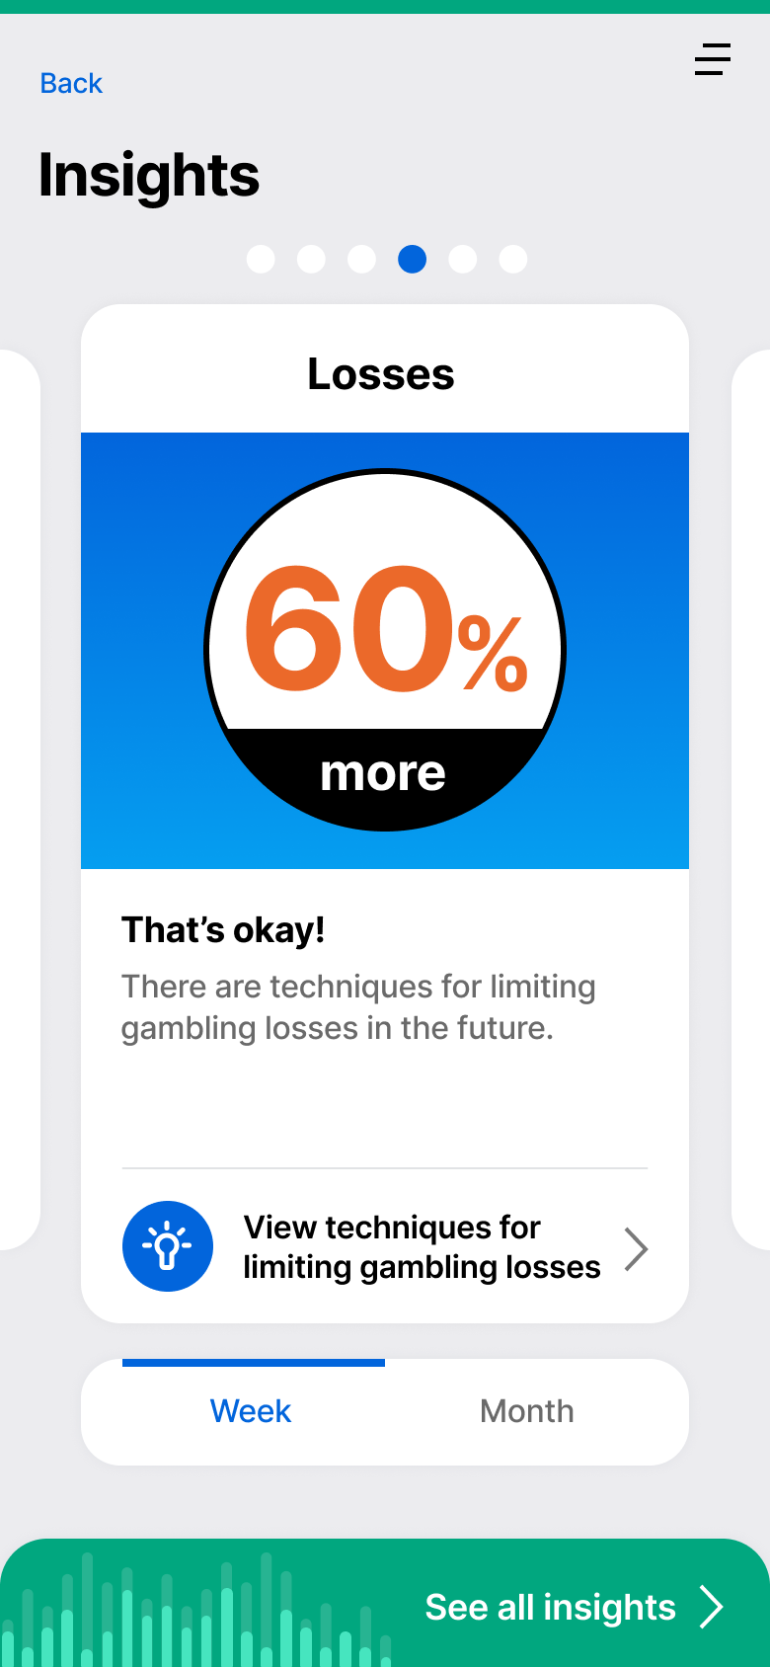
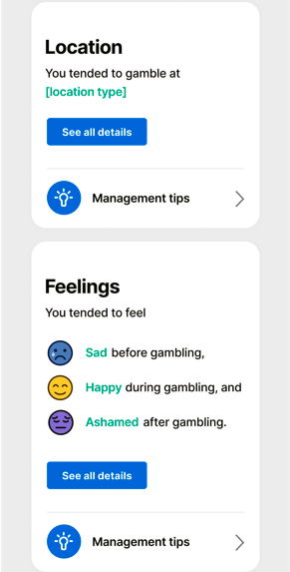
SPRinG: Insights
“It [the GAP] helps you, like in your thinking process … it points out in the program … How your thinking process works when you’re a gambler and how to try and stop it from happening and … sometimes now I’m successful at doing it … I start thinking, you know, I’ve been wrong so many times and this one’s probably not going to happen either”

Slide 35
Summary of SPRinG Features
Feature | Description
Gambling Symptom Assessment Scale | Being aware of these results can help individuals make informed decisions about how to manage their gambling behaviour.
Problem Gambling Severity Index | App users will be able to complete the scale on a weekly basis to track a possible reduction in problem gambling harms.
Urge Troubleshooting | Four troubleshooting options are available, including contact a friend, contact a crisis line or other resources, try a distraction activity, or learn about other strategies.
Urge Journal | Recording urges will help individuals identify the triggers and high-risk situations and develop targeted strategies for managing urges to gamble.
Gambling Journal | Understanding the patterns in the variables related to gambling events will help individuals learn strategies for limiting their gambling and/or reducing its harms.
Insights | Using the Insights feature, individuals can view patterns in their urge and gambling experiences. The urge and gambling situation section present information that will help individuals’ identity possible triggers and high risk situations.
SOS Page | Crisis lines and problem gambling resources that individuals can access at anytime if they are feeling distressed.

Slide 36
SPRinG App Research
There is a lack of research examining self-management approaches tailored to specific groups (e.g., age, income, gender, ethnicity, geography)
Further research is needed to understand what self-management approaches may be appropriate and effective for a variety of populations
App will generate knowledge on:
  The impact of the mHealth technology on the severity of gambling symptoms and other related outcomes
  The engagement and feasibility of using a mobile app in the gambling domain

Slide 37
Next Steps
Currently in final phases of development
Tentative app launch Summer 2022
Initiation of feasibility study
All study data collected within app
Study enrollment completed within app
Links to download SPRinG app will be posted on study website
  https://maphealth.ca/problem-gambling-complex/
SPRinG app will be available in Apple and Google App Stores
Interested in becoming a partner?

Slide 38
Q&A

Slide 39
Gambling, Gaming, and Technology Use (GGTU)
Website: https://kmb.camh.ca/ggtu
Subscribe to our Newsletter! For more training check out our website
https://kmb.camh.ca/ggtu/trainings
Join the GGTU Community of Interest!
https://www.eenetconnect.ca/g/gambling-gaming-technology-use

Slide 40
Flora Matheson Flora.Matheson@unityhealth.to
Arthur McLuhan Arthur.McLuhan@unityhealth.to
Madison Ford Madison.Ford@unityhealth.to
Notes:
ADD LINK TO WEBSITE

Slide 41
References
Cowlishaw S, Merkouris S, Chapman A, Radermacher H. Pathological and problem gambling in substance use treatment: A systematic review and meta-analysis. Journal of Substance Abuse Treatment. 2014;46(2):98-105.
Ferentzy P, Skinner WW, Matheson FI. Illicit drug use and problem gambling. ISRN Addiction. 2013;2013.
Matheson FI, Devotta K, Wendaferew A, Pedersen C. Prevalence of gambling problems among the clients of a toronto homeless shelter. J Gambl Stud. 2014;30(2):537-546.
Roberts A, Sharman S, Coid J, et al. Gambling and negative life events in a nationally representative sample of UK men. Addictive behaviors. 2017;75:95-102.
Matheson, F. I., et al. (2021). "Prevalence of Problem Gambling Among Women Using Shelter and Drop-in Services." International Journal of Mental Health and Addiction: 1-12.
Barlow, J., Wright, C., Sheasby, J., Turner, A., & Hainsworth, J. (2002). Self management approaches for people with chronic conditions. Patient Education and Counseling, 48, 177–187.

Slide 42
References
Sanchez S, Jindani F, Shi J, et al. Acceptability of Internet-based interventions for problem gambling: a qualitative study of focus groups with clients and clinicians. BMC Med Inform Decis Mak. 2019;19(1):290.
van der Maas M, Shi J, Elton-Marshall T, et al. Internet-Based Interventions for Problem Gambling: Scoping Review. JMIR Ment Health. 2019;6(1):e65-e65.
Guilcher SJ, Hamilton-Wright S, Skinner W, et al. “Talk with me”: perspectives on services for men with problem gambling and housing instability. BMC health services research. 2016;16(1):340.
Hawker CO, Merkouris SS, Youssef GJ, Dowling NA. A Smartphone-Delivered Ecological Momentary Intervention for Problem Gambling (GamblingLess: Curb Your Urge): Single-Arm Acceptability and Feasibility Trial. J Med Internet Res. 2021;23(3):e25786.
Matheson FI, Hamilton-Wright S, McLuhan A, et al. Self-Management Strategies for Problem Gambling in the Context of Poverty and Homelessness. Journal of Gambling Issues. 2021;48:81-109.

Slide 43
References
Tara Hahmann, Sarah Hamilton-Wright, Carolyn Ziegler & Flora I. Matheson (2021) Problem gambling within the context of poverty: a scoping review, International Gambling Studies, 21:2, 183-219.
Guilcher SJ, Hamilton-Wright S, Skinner W, et al. "Talk with me": perspectives on services for men with problem gambling and housing instability. BMC Health Serv Res 2016; 16(a): 340.
Guilcher SJT, Cadel L, Everall AC, et al. Factors related to screening for problem gambling among healthcare and social service providers in Ontario, Canada: A concept mapping study. Health Soc Care Community 2020; 28(3): 791-802.
Woodhall-Melnik J, Hamilton-Wright S, Guilcher SJ, Wendaferew A, Schuler A, Matheson FI. Reflections on poverty, Homelessness and problem gambling: Discoveries from a world cafe. Journal of Gambling Issues 2019; 42.

